Slide 1
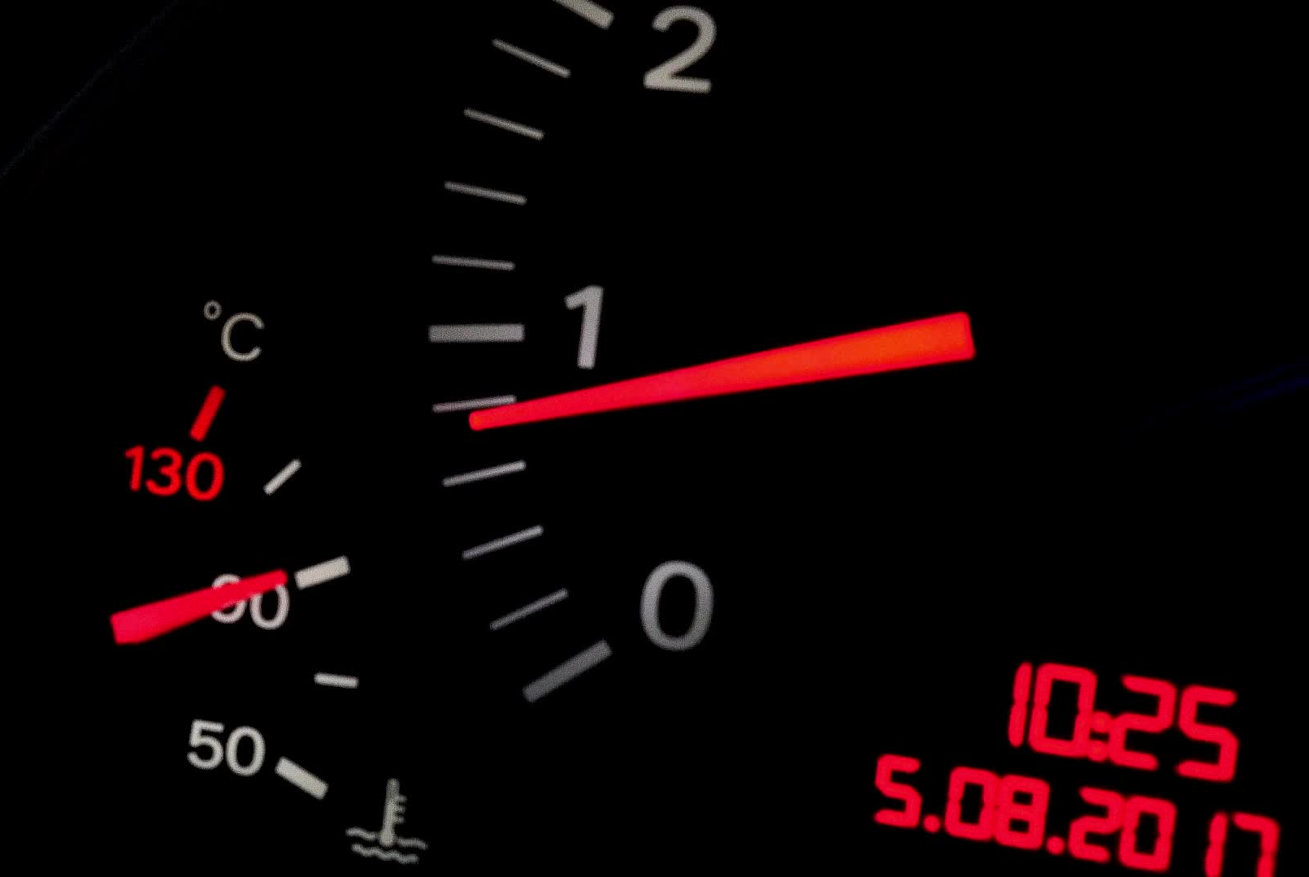
Multimeter

Slide 2
Multimeter:
As the name implies, a multimeter is device that can be used to measure multiple quantities, i.e., when a single device is used to measure multiple quantities, the device is called multimeter. On the basis of output representation, there are two types of multimeters −
Analog multimeter
Digital multimeter

Slide 3
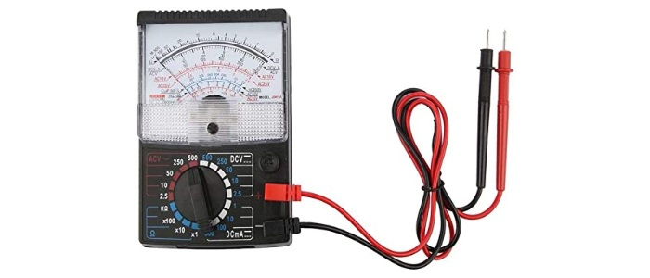
Analog Multimeter:
An analog multimeter is a permanent magnet moving coil (PMMC) meter type measuring instrument.The analog multimeter has an analog display that uses the deflection of a pointer on the scale to indicate the level of measurement being made. The pointer deflects from its initial position increasingly as the measuring quantity increases.

Slide 4
Working of Analog Multimeter:
Since, the analog multimeter is a PMMC types instrument, so when a current is passed through its coil, the coil moves in a magnetic field produced by the permanent magnet. A pointer is attached with the coil. When current flows in the coil, a deflecting torque acts on the coil that will rotate it by an angle, so the pointer moves over a scale. A pair of hairsprings is attached to the spindle to provide the controlling torque.

Slide 5
Analog Multimeter Measuring Quantities:
A typical analog multimeter can measure following electrical quantities −
DC Voltage
AC Voltage
DC Current
Resistance

Slide 6
Advantages of Analog Multimeter:
It gives the continuous reading, thus a sudden change in signal can be detected which is not possible with digital multimeter.
Analog multimeter are very cheap.
All measurement can be made using a single meter only.
Disadvantages of Analog Multimeter:
They are bulky and larger sized.
Multiple scales, these can cause confusion.
Low input resistance.
Analog multimeters do not have auto-polarity function. Therefore, it is necessary to connect probes correctly.
Less accurate than a digital multimeter.

Slide 7
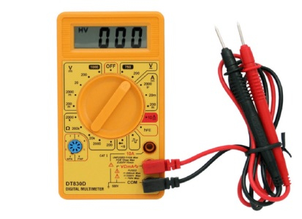
Digital Multimeter:
A digital multimeter (DMM) is a measuring instrument used to measure various electrical quantities. The standard measurements that are performed by a DMM are current, voltage and resistance. Apart from these, a digital multimeter can also measure temperature, frequency, capacitance, continuity, transistor gains etc.

Slide 8
Advantages of Digital Multimeter:
Cheap and easily available.
Auto range according to requirements.
Smaller size and light in weight.
Auto off.
Auto polarity, etc.

